Slide 1
Chapter 9 & 10: Transactions
Recovery System and Concurrency Control

Slide 2
Transaction Concept
A transaction is a unit of program execution that accesses and possibly updates various data items.
Most database system ensures that users accessing s database and manipulating data do not make the inconsistent i.e. A transaction must see a consistent database. They accomplish this by using the concept of transaction.
During transaction execution the database may be inconsistent. When the transaction is committed, the database must be consistent.
Beside ensuring consistency, transactions have many other properties which are enforced by database systems. For example, a transaction cannot be executed partially- it is either executed in its entirety or not at all.
Transactions allow a group of statements to be executed as one logical “atomic” action.

Slide 3
Transaction Concept
Transactions allow multiple users to access and update a database simultaneously by guaranteeing that their actions will not interfere with each other.
Finally, if a transaction executes successfully, the database system guarantees that the changes made by transaction will be reflected in the database even if the database system crashes immediately after its execution.
Two main issues to deal with:
  Failures of various kinds, such as hardware failures and system crashes
  Concurrent execution of multiple transactions
Transaction in SQL
START TRANSACTION;
SQL Statement;
COMMIT;

Slide 4
ACID Properties
To preserve integrity of data, the database system must ensure:
Atomicity. Either all operations of the transaction are properly reflected in the database or none are.
Consistency. Execution of a transaction in isolation preserves the consistency of the database.
Isolation. Although multiple transactions may execute concurrently, each transaction must be unaware of other concurrently executing transactions. Intermediate transaction results must be hidden from other concurrently executed transactions.
  That is, for every pair of transactions T_{i} and T_{j}, it appears to T_{i} that either T_{j}, finished execution before T_{i} started, or T_{j} started execution after T_{i} finished.
Durability. After a transaction completes successfully, the changes it has made to the database persist, even if there are system failures.

Slide 5
Example of Fund Transfer
Transaction to transfer $50 from account A to account B:
  1. read(A)
  2. A := A – 50
  3. write(A)
  4. read(B)
  5. B := B + 50
  6. write(B)
Consistency requirement – the sum of A and B is unchanged by the execution of the transaction.
Atomicity requirement — if the transaction fails after step 3 and before step 6, the system should ensure that its updates are not reflected in the database, else an inconsistency will result.

Slide 6
Example of Fund Transfer (Cont.)
Durability requirement — once the user has been notified that the transaction has completed (i.e., the transfer of the $50 has taken place), the updates to the database by the transaction must persist despite failures.
Isolation requirement — if between steps 3 and 6, another transaction is allowed to access the partially updated database, it will see an inconsistent database
(the sum A + B will be less than it should be).
Can be ensured trivially by running transactions serially, that is one after the other. However, executing multiple transactions concurrently has significant benefits, as we will see.

Slide 7

Transaction State
Active, the initial state; the transaction stays in this state while it is executing
Partially committed, after the final statement has been executed.
Failed, after the discovery that normal execution can no longer proceed.
Aborted, after the transaction has been rolled back and the database restored to its state prior to the start of the transaction. Two options after it has been aborted:
  restart the transaction – only if no internal logical error
  kill the transaction
Committed, after successful completion.

Slide 8
Concurrent Executions
The process of managing simultaneous operations on the database without having them interfere with one another.
DBMSs are required to allow simultaneous, (concurrent), multi-user access
    multiple users within the one application accessing the same files.
    users in different applications accessing the same files.
Multiple transactions are allowed to run concurrently in the system. Advantages are:
  increased processor and disk utilization, leading to better transaction throughput: one transaction can be using the CPU while another is reading from or writing to the disk
  reduced average response time for transactions: short transactions need not wait behind long ones.

Slide 9
Concurrency control schemes – mechanisms to achieve isolation, i.e., to control the interaction among the concurrent transactions in order to prevent them from destroying the consistency of the database
Without centralized concurrency control, two types of problem can occur:
The lost update problem.
The so-called “ dirty-read” problem, also described as allowing a transaction to view the partial, (uncommitted), results of another transaction.

Slide 10
Concurrency Control in a Multi-user Environment The ‘lost update’ problem - sample scenario
Consider the relation:
PRODUCT(prod-code,description,unit-price, quantity-onhand)
Assume a particular record in the file is:
P45 Board-marker 25.50 35
Concurrent User 1, (in the Warehouse), has just received a shipment of twenty P45s.
Concurrent User 2, (a salesman), has just received an order for ten P45s.
CU1, (Concurrent User 1), and CU2 initiate transactions which each read the same P45 record. In each CWA (current work area), the field Q-O-H, Quantity-On-Hand, shows 35.
CU2’s transaction reduces Q-O-H by 10, and rewrites the record, (overwriting the old record), with Q-O-H of 25.
CU1’s transaction, a moment later, increments Q-O-H by 20 to 55, and rewrites the record, overwriting the existing record, (the one just written by CU2’s transaction).
Quantity-On-Hand thus shows 55, when it should show
    35 - 10 + 20, i.e. 45. CU2’s update has been “ lost”.

Slide 11
Concurrency Control in a Multi-user Environment The “dirty-read” problem - similar sample scenario
Consider again the relation:
PRODUCT(prod-code,description,unit-price, quantity-onhand)
Assume again a particular record in the file is:
P45 Board-marker 25.50 35
Concurrent User 1, (in the Warehouse), has just received a shipment of twenty P54s. (Note: P54s – not P45s.)
Concurrent User 2, (a salesman), has just received an order for ten P45s.
CU1 initiates the Warehouse update transaction, but by mistake keys in “P45”, instead of “ P54”. The transaction reads the P45 record with Q-O-H of 35, updates it to 55, and rewrites it (in a shared memory area for example).
A moment later, CU2’s transaction reads CU1’s update showing the value of Q-O-H as 55.
Just then, CU1, realizing the error, aborts the transaction, which executes rollback.
A moment later, CU2’s transaction, having decremented QO- H, rewrites it as 45.
Quantity-On-Hand thus shows 45, when it should show 35 - 10 = 25. By viewing the uncommitted results of CU1’s

Slide 12
Schedules
Schedules – sequences that indicate the chronological order in which instructions of concurrent transactions are executed
  a schedule for a set of transactions must consist of all instructions of those transactions
  must preserve the order in which the instructions appear in each individual transaction.

Slide 13

Example Schedules
Let T₁ transfer $50 from A to B, and T₂ transfer 10% of the balance from A to B. The following is a serial schedule (Schedule 1 in the text), in which T₁ is followed by T₂.

Slide 14

Example Schedule (Cont.)
Let T₁ and T₂ be the transactions defined previously. The following schedule (Schedule 3 in the text) is not a serial schedule, but it is equivalent to Schedule 1.
In both Schedule 1 and 3, the sum A + B is preserved.

Slide 15

Example Schedules (Cont.)
The following concurrent schedule (Schedule 4 in the text) does not preserve the value of the the sum A + B.

Slide 16
Serializability
Basic Assumption – Each transaction preserves database consistency.
Thus serial execution of a set of transactions preserves database consistency.
A (possibly concurrent) schedule is serializable if it is equivalent to a serial schedule. Different forms of schedule equivalence give rise to the notions of:
  1. conflict serializability
  2. view serializability
We ignore operations other than read and write instructions, and we assume that transactions may perform arbitrary computations on data in local buffers in between reads and writes. Our simplified schedules consist of only read and write instructions.

Slide 17
Conflict Serializability
Instructions l_{i} and l_{j} of transactions T_{i} and T_{j} respectively, conflict if and only if there exists some item Q accessed by both l_{i} and l_{j}, and at least one of these instructions wrote Q.
1. l_{i} = read(Q), l_{j} = read(Q). l_{i} and l_{j} don’t conflict.
2. l_{i} = read(Q), l_{j} = write(Q). They conflict.
3. l_{i} = write(Q), l_{j} = read(Q). They conflict
4. l_{i} = write(Q), l_{j} = write(Q). They conflict
Intuitively, a conflict between l_{i} and l_{j} forces a (logical) temporal order between them. If l_{i} and l_{j} are consecutive in a schedule and they do not conflict, their results would remain the same even if they had been interchanged in the schedule.

Slide 18
Conflict Serializability (Cont.)
If a schedule S can be transformed into a schedule S´ by a series of swaps of non-conflicting instructions, we say that S and S´ are conflict equivalent.
We say that a schedule S is conflict serializable if it is conflict equivalent to a serial schedule
Example of a schedule that is not conflict serializable:
T₃ T₄
read(Q)
write(Q)
write(Q)
We are unable to swap instructions in the above schedule to obtain either the serial schedule < T₃, T₄ >, or the serial schedule < T₄, T₃ >.

Slide 19

Conflict Serializability (Cont.)
Schedule 3 below can be transformed into Schedule 1, a serial schedule where T₂ follows T₁, by series of swaps of non-conflicting instructions. Therefore Schedule 3 is conflict serializable.

Slide 20
View Serializability
Let S and S´ be two schedules with the same set of transactions. S and S´ are view equivalent if the following three conditions are met:
  1. For each data item Q, if transaction T_{i} reads the initial value of Q in schedule S, then transaction T_{i} must, in schedule S´, also read the initial value of Q.
  2. For each data item Q if transaction T_{i} executes read(Q) in schedule S, and that value was produced by transaction T_{j} (if any), then transaction T_{i} must in schedule S´ also read the value of Q that was produced by transaction T_{j} .
  3. For each data item Q, the transaction (if any) that performs the final write(Q) operation in schedule S must perform the final write(Q) operation in schedule S´.
As can be seen, view equivalence is also based purely on reads
and writes alone.

Slide 21
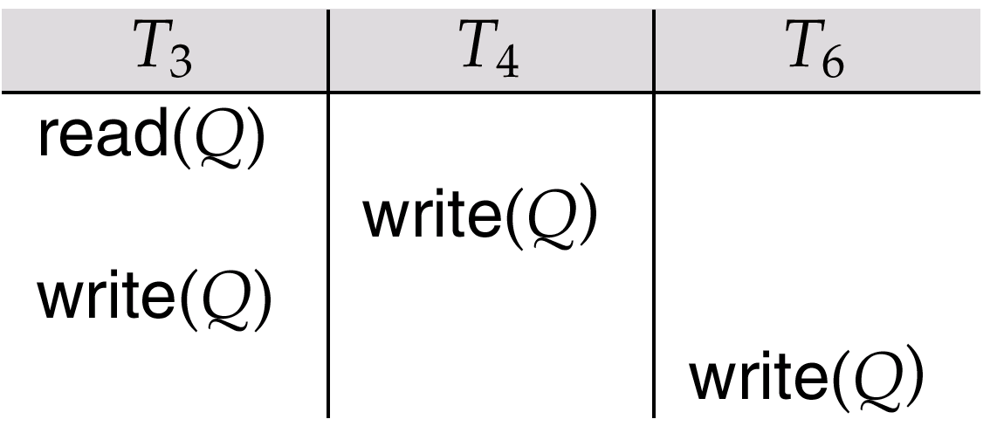
View Serializability (Cont.)
A schedule S is view serializable it is view equivalent to a serial schedule.
Every conflict serializable schedule is also view serializable.
Schedule 9 (from text) — a schedule which is view-serializable but not conflict serializable.
Every view serializable schedule that is not conflict
serializable has blind writes.

Slide 22
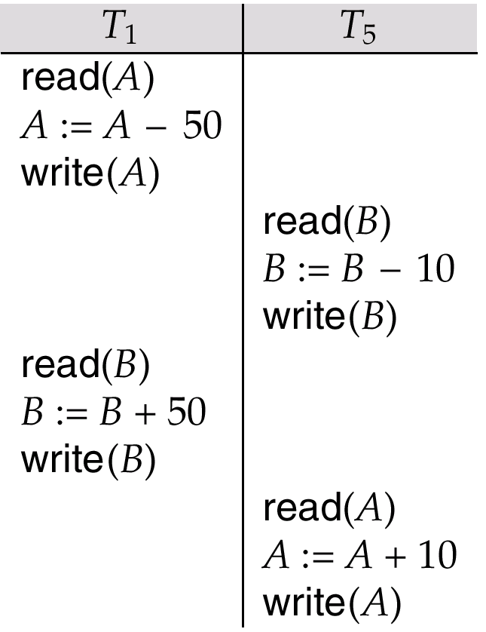
Other Notions of Serializability
Schedule 8 (from text) given below produces same outcome as the serial schedule < T₁, T₅ >, yet is not conflict equivalent or view equivalent to it.
Determining such equivalence requires analysis of operations other than read and write.

Slide 23
Lock-Based Protocols
A lock is a mechanism to control concurrent access to a data item
Data items can be locked in two modes :
1. exclusive (X) mode. Data item can be both read as well as
written. X-lock is requested using lock-X instruction.
2. shared (S) mode. Data item can only be read. S-lock is
requested using lock-S instruction.
Lock requests are made to concurrency-control manager. Transaction can proceed only after request is granted.

Slide 24

Lock-Based Protocols (Cont.)
Lock-compatibility matrix
A transaction may be granted a lock on an item if the requested lock is compatible with locks already held on the item by other transactions
Any number of transactions can hold shared locks on an item, but if any transaction holds an exclusive on the item no other transaction may hold any lock on the item.
If a lock cannot be granted, the requesting transaction is made to wait till all incompatible locks held by other transactions have been released. The lock is then granted.

Slide 25
Lock-Based Protocols (Cont.)
Example of a transaction performing locking:
T₂: lock-S(A);
read (A);
unlock(A);
lock-S(B);
read (B);
unlock(B);
display(A+B)
Locking as above is not sufficient to guarantee serializability — if A and B get updated in-between the read of A and B, the displayed sum would be wrong.
A locking protocol is a set of rules followed by all transactions while requesting and releasing locks. Locking protocols restrict the set of possible schedules.

Slide 26

Pitfalls of Lock-Based Protocols
Consider the partial schedule
Neither T₃ nor T₄ can make progress — executing lock-S(B) causes T₄ to wait for T₃ to release its lock on B, while executing lock-X(A) causes T₃ to wait for T₄ to release its lock on A.
Such a situation is called a deadlock.
  To handle a deadlock one of T₃ or T₄ must be rolled back
  and its locks released.

Slide 27
Pitfalls of Lock-Based Protocols (Cont.)
The potential for deadlock exists in most locking protocols. Deadlocks are a necessary evil.
Starvation is also possible if concurrency control manager is badly designed. For example:
  A transaction may be waiting for an X-lock on an item, while a sequence of other transactions request and are granted an S-lock on the same item.
  The same transaction is repeatedly rolled back due to deadlocks.
Concurrency control manager can be designed to prevent starvation.

Slide 28
The Two-Phase Locking Protocol
This is a protocol which ensures conflict-serializable schedules.
Phase 1: Growing Phase
  transaction may obtain locks
  transaction may not release locks
Phase 2: Shrinking Phase
  transaction may release locks
  transaction may not obtain locks
The protocol assures serializability. It can be proved that the transactions can be serialized in the order of their lock points (i.e. the point where a transaction acquired its final lock).

Slide 29
The Two-Phase Locking Protocol (Cont.)
Two-phase locking does not ensure freedom from deadlocks
Cascading roll-back is possible under two-phase locking. To avoid this, follow a modified protocol called strict two-phase locking. Here a transaction must hold all its exclusive locks till it commits/aborts.
Rigorous two-phase locking is even stricter: here all locks are held till commit/abort. In this protocol transactions can be serialized in the order in which they commit.
Let us consider the transaction:
  R(A) W(A) R(B) W(B) R(C) W(C) R(D) W(D)
  strict two-phase locking:
  X (A) R(A) W(A) X(B) R(B) W(B) X(C) R(C) W(C) X(D) R(D) W(D) U(A)U(B)U(C) U(D)
  Rigorous two-phase locking
  X (A) X(B) X(C) X(D) R(A) W(A) R(B) W(B) R(C) W(C) R(D) W(D) U(A)U(B)U(C) U(D)

Slide 30
The Two-Phase Locking Protocol (Cont.)
There can be conflict serializable schedules that cannot be obtained if two-phase locking is used.
However, in the absence of extra information (e.g., ordering of access to data), two-phase locking is needed for conflict serializability in the following sense:
Given a transaction T_{i} that does not follow two-phase locking, we can find a transaction T_{j} that uses two-phase locking, and a schedule for T_{i} and T_{j} that is not conflict serializable.

Slide 31
Implementation of Locking
A Lock manager can be implemented as a separate process to which transactions send lock and unlock requests
The lock manager replies to a lock request by sending a lock grant messages (or a message asking the transaction to roll back, in case of a deadlock)
The requesting transaction waits until its request is answered
The lock manager maintains a datastructure called a lock table to record granted locks and pending requests
The lock table is usually implemented as an in-memory hash table indexed on the name of the data item being locked

Slide 32
Timestamp-Based Protocols
Each transaction is issued a timestamp when it enters the system. If an old transaction T_{i} has time-stamp TS(T_{i}), a new transaction T_{j} is assigned time-stamp TS(T_{j}) such that TS(T_{i}) <TS(T_{j}).
The protocol manages concurrent execution such that the time-stamps determine the serializability order.
In order to assure such behavior, the protocol maintains for each data Q two timestamp values:
  W-timestamp(Q) is the largest time-stamp of any transaction that executed write(Q) successfully.
  R-timestamp(Q) is the largest time-stamp of any transaction that executed read(Q) successfully.

Slide 33
Timestamp-Based Protocols (Cont.)
The timestamp ordering protocol ensures that any conflicting read and write operations are executed in timestamp order.
Suppose a transaction T_{i} issues a read(Q)
1. If TS(T_{i}) ≤ W-timestamp(Q), then T_{i} needs to read a value of Q
that was already overwritten. Hence, the read operation is
rejected, and T_{i} is rolled back.
2. If TS(T_{i})≥ W-timestamp(Q), then the read operation is
executed, and R-timestamp(Q) is set to the maximum of R-
timestamp(Q) and TS(T_{i}).

Slide 34
Timestamp-Based Protocols (Cont.)
Suppose that transaction T_{i} issues write(Q).
If TS(T_{i}) < R-timestamp(Q), then the value of Q that T_{i} is producing was needed previously, and the system assumed that that value would never be produced. Hence, the write operation is rejected, and T_{i} is rolled back.
If TS(T_{i}) < W-timestamp(Q), then T_{i} is attempting to write an obsolete value of Q. Hence, this write operation is rejected, and T_{i} is rolled back.
Otherwise, the write operation is executed, and W-timestamp(Q) is set to TS(T_{i}).

Slide 35
Example Use of the Protocol
A partial schedule for several data items for transactions with
timestamps 1, 2, 3, 4, 5
T₁
T₂
T₃
T₄
T₅
read(X)
read(Y)
read(Y)
write(Y)
write(Z)
read(Z)
read(X)
abort
read(X)
write(Z)
abort
write(Y)
write(Z)

Slide 36
Correctness of Timestamp-Ordering Protocol
The timestamp-ordering protocol guarantees serializability since all the arcs in the precedence graph are of the form:
Thus, there will be no cycles in the precedence graph
Timestamp protocol ensures freedom from deadlock as no transaction ever waits.
But the schedule may not be cascade-free, and may not even be recoverable.
transaction
with smaller
timestamp
transaction
with larger
timestamp

Slide 37
Recoverability and Cascade Freedom
Problem with timestamp-ordering protocol:
  Suppose T_{i} aborts, but T_{j} has read a data item written by T_{i}
  Then T_{j} must abort; if T_{j} had been allowed to commit earlier, the schedule is not recoverable.
  Further, any transaction that has read a data item written by T_{j} must abort
  This can lead to cascading rollback --- that is, a chain of rollbacks
Solution:
  A transaction is structured such that its writes are all performed at the end of its processing
  All writes of a transaction form an atomic action; no transaction may execute while a transaction is being written
  A transaction that aborts is restarted with a new timestamp

Slide 38
Multiple Granularity
Allow data items to be of various sizes and define a hierarchy of data granularities, where the small granularities are nested within larger ones
Can be represented graphically as a tree (but don't confuse with tree-locking protocol)
When a transaction locks a node in the tree explicitly, it implicitly locks all the node's descendents in the same mode.
Granularity of locking (level in tree where locking is done):
  fine granularity (lower in tree): high concurrency, high locking overhead
  coarse granularity (higher in tree): low locking overhead, low concurrency

Slide 39
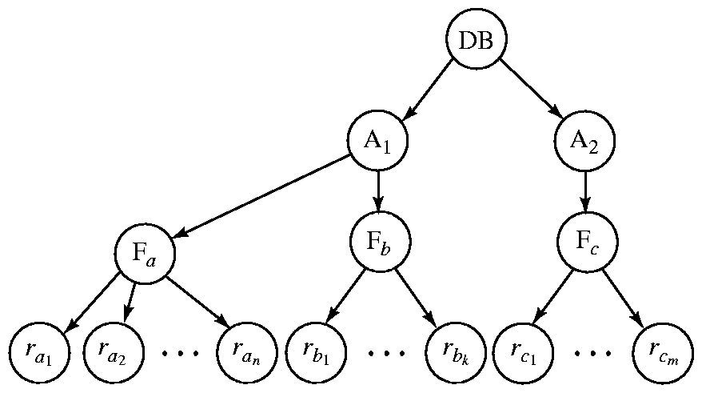
Example of Granularity Hierarchy
The highest level in the example hierarchy is the entire database.
The levels below are of type area, file and record in that order.

Slide 40
Deadlock Handling
Consider the following two transactions:
T₁: write (X) T₂: write(Y)
write(Y) write(X)
Schedule with deadlock
T₁
T₂
lock-X on X
write (X)
lock-X on Y
write (X)
wait for lock-X on X
wait for lock-X on Y

Slide 41
Deadlock Handling
System is deadlocked if there is a set of transactions such that every transaction in the set is waiting for another transaction in the set.
Deadlock prevention protocols ensure that the system will never enter into a deadlock state. Some prevention strategies :
  Require that each transaction locks all its data items before it begins execution (predeclaration).
  Impose partial ordering of all data items and require that a transaction can lock data items only in the order specified by the partial order (graph-based protocol).

Slide 42
More Deadlock Prevention Strategies
Following schemes use transaction timestamps for the sake of deadlock prevention alone.
wait-die scheme — non-preemptive
  older transaction may wait for younger one to release data item. Younger transactions never wait for older ones; they are rolled back instead.
  a transaction may die several times before acquiring needed data item
wound-wait scheme — preemptive
  older transaction wounds (forces rollback) of younger transaction instead of waiting for it. Younger transactions may wait for older ones.
  may be fewer rollbacks than wait-die scheme.

Slide 43
Deadlock prevention (Cont.)
Both in wait-die and in wound-wait schemes, a rolled back transactions is restarted with its original timestamp. Older transactions thus have precedence over newer ones, and starvation is hence avoided.
Timeout-Based Schemes :
  a transaction waits for a lock only for a specified amount of time. After that, the wait times out and the transaction is rolled back.
  thus deadlocks are not possible
  simple to implement; but starvation is possible. Also difficult to determine good value of the timeout interval.

Slide 44
Recovery System

Slide 45
Failure Classification
Transaction failure :
  Logical errors: transaction cannot complete due to some internal error condition
  System errors: the database system must terminate an active transaction due to an error condition (e.g., deadlock)
System crash: a power failure or other hardware or software failure causes the system to crash.
  Fail-stop assumption: non-volatile storage contents are assumed to not be corrupted by system crash
    Database systems have numerous integrity checks to prevent corruption of disk data
Disk failure: a head crash or similar disk failure destroys all or part of disk storage
  Destruction is assumed to be detectable: disk drives use checksums to detect failures

Slide 46
Recovery Algorithms
Recovery algorithms are techniques to ensure database consistency and transaction atomicity and durability despite failures
  Focus of this chapter
Recovery algorithms have two parts
  Actions taken during normal transaction processing to ensure enough information exists to recover from failures
  Actions taken after a failure to recover the database contents to a state that ensures atomicity, consistency and durability

Slide 47
Storage Structure
Volatile storage:
  does not survive system crashes
  examples: main memory, cache memory
Nonvolatile storage:
  survives system crashes
  examples: disk, tape, flash memory,
  non-volatile (battery backed up) RAM
Stable storage:
  a mythical form of storage that survives all failures
  approximated by maintaining multiple copies on distinct nonvolatile media

Slide 48
Recovery and Atomicity
Modifying the database without ensuring that the transaction will commit may leave the database in an inconsistent state.
Consider transaction T_{i} that transfers $50 from account A to account B; goal is either to perform all database modifications made by T_{i} or none at all.
Several output operations may be required for T_{i} (to output A and B). A failure may occur after one of these modifications have been made but before all of them are made.

Slide 49
Recovery and Atomicity (Cont.)
To ensure atomicity despite failures, we first output information describing the modifications to stable storage without modifying the database itself.
We study two approaches:
  log-based recovery, and
  shadow-paging
We assume (initially) that transactions run serially, that is, one after the other.

Slide 50
Log-Based Recovery
A log is kept on stable storage.
  The log is a sequence of log records, and maintains a record of update activities on the database.
When transaction T_{i} starts, it registers itself by writing a
<T_{i} start>log record
Before T_{i} executes write(X), a log record <T_{i}, X, V₁, V₂> is written, where V₁ is the value of X before the write, and V₂ is the value to be written to X.
  Log record notes that T_{i} has performed a write on data item X_{j} X_{j} had value V₁ before the write, and will have value V₂ after the write.
When T_{i} finishes it last statement, the log record <T_{i} commit> is written.
We assume for now that log records are written directly to stable storage (that is, they are not buffered)
Two approaches using logs
  Deferred database modification
  Immediate database modification

Slide 51
Deferred Database Modification
The deferred database modification scheme records all modifications to the log, but defers all the writes to after partial commit.
Assume that transactions execute serially
Transaction starts by writing <T_{i} start> record to log.
A write(X) operation results in a log record <T_{i}, X, V> being written, where V is the new value for X
  Note: old value is not needed for this scheme
The write is not performed on X at this time, but is deferred.
When T_{i} partially commits, <T_{i} commit> is written to the log
Finally, the log records are read and used to actually execute the previously deferred writes.

Slide 52
Deferred Database Modification (Cont.)
During recovery after a crash, a transaction needs to be redone if and only if both <T_{i} start> and<T_{i} commit> are there in the log.
Redoing a transaction T_{i} ( redoT_{i}) sets the value of all data items updated by the transaction to the new values.
Crashes can occur while
  the transaction is executing the original updates, or
  while recovery action is being taken
example transactions T₀ and T₁ (T₀ executes before T₁):
T₀: read (A) T₁ : read (C)
A: - A - 50 C:- C- 100
Write (A) write (C)
read (B)
B:- B + 50
write (B)

Slide 53

Deferred Database Modification (Cont.)
Below we show the log as it appears at three instances of time.
If log on stable storage at time of crash is as in case:
(a) No redo actions need to be taken
(b) redo(T₀) must be performed since <T₀ commit> is present
(c) redo(T₀) must be performed followed by redo(T₁) since
<T₀ commit> and <T_{i} commit> are present

Slide 54
Immediate Database Modification
The immediate database modification scheme allows database updates of an uncommitted transaction to be made as the writes are issued
  since undoing may be needed, update logs must have both old value and new value
Update log record must be written before database item is written
  We assume that the log record is output directly to stable storage
  Can be extended to postpone log record output, so long as prior to execution of an output(B) operation for a data block B, all log records corresponding to items B must be flushed to stable storage
Output of updated blocks can take place at any time before or after transaction commit
Order in which blocks are output can be different from the order in which they are written.

Slide 55
Immediate Database Modification Example
Log Write Output
<T₀ start>
<T₀, A, 1000, 950>
T_{o}, B, 2000, 2050
A = 950
B = 2050
<T₀ commit>
<T₁ start>
<T₁, C, 700, 600>
C = 600
B_{B}, B_{C}
<T₁ commit>
B_{A}
Note: B_{X} denotes block containing X.
x₁

Slide 56
Immediate Database Modification (Cont.)
Recovery procedure has two operations instead of one:
  undo(T_{i}) restores the value of all data items updated by T_{i} to their old values, going backwards from the last log record for T_{i}
  redo(T_{i}) sets the value of all data items updated by T_{i} to the new values, going forward from the first log record for T_{i}
Both operations must be idempotent
  That is, even if the operation is executed multiple times the effect is the same as if it is executed once
    Needed since operations may get re-executed during recovery
When recovering after failure:
  Transaction T_{i} needs to be undone if the log contains the record
  <T_{i} start>, but does not contain the record <T_{i} commit>.
  Transaction T_{i} needs to be redone if the log contains both the record <T_{i} start> and the record <T_{i} commit>.
Undo operations are performed first, then redo operations.

Slide 57

Immediate DB Modification Recovery Example
Below we show the log as it appears at three instances of time.
Recovery actions in each case above are:
(a) undo (T₀): B is restored to 2000 and A to 1000.
(b) undo (T₁) and redo (T₀): C is restored to 700, and then A and B are
set to 950 and 2050 respectively.
(c) redo (T₀) and redo (T₁): A and B are set to 950 and 2050
respectively. Then C is set to 600

Slide 58
Checkpoints
Problems in recovery procedure as discussed earlier :
  searching the entire log is time-consuming
  we might unnecessarily redo transactions which have already
  output their updates to the database.
Streamline recovery procedure by periodically performing checkpointing
  Output all log records currently residing in main memory onto stable storage.
  Output all modified buffer blocks to the disk.
  Write a log record < checkpoint> onto stable storage.

Slide 59
Checkpoints (Cont.)
During recovery we need to consider only the most recent transaction T_{i} that started before the checkpoint, and transactions that started after T_{i}.
  Scan backwards from end of log to find the most recent <checkpoint> record
  Continue scanning backwards till a record <T_{i} start> is found.
  Need only consider the part of log following above start record. Earlier part of log can be ignored during recovery, and can be erased whenever desired.
  For all transactions (starting from T_{i} or later) with no <T_{i} commit>, execute undo(T_{i}). (Done only in case of immediate modification.)
  Scanning forward in the log, for all transactions starting from T_{i} or later with a <T_{i} commit>, execute redo(T_{i}).

Slide 60
Example of Checkpoints
T_{c}
T_{f}
T₁ can be ignored (updates already output to disk due to checkpoint)
T₂ and T₃ redone.
T₄ undone
T₁
T₂
T₃
T₄
checkpoint
system failure

Slide 61
Shadow Paging
Shadow paging is an alternative to log-based recovery; this scheme is useful if transactions execute serially
Idea: maintain two page tables during the lifetime of a transaction –the current page table, and the shadow page table
Store the shadow page table in nonvolatile storage, such that state of the database prior to transaction execution may be recovered.
  Shadow page table is never modified during execution
To start with, both the page tables are identical. Only current page table is used for data item accesses during execution of the transaction.
Whenever any page is about to be written for the first time
  A copy of this page is made onto an unused page.
  The current page table is then made to point to the copy
  The update is performed on the copy

Slide 62

Sample Page Table

Slide 63

Example of Shadow Paging
Shadow and current page tables after write to page 4

Slide 64
Shadow Paging (Cont.)
To commit a transaction :
1. Flush all modified pages in main memory to disk
2. Output current page table to disk
3. Make the current page table the new shadow page table, as follows:
  keep a pointer to the shadow page table at a fixed (known) location on disk.
  to make the current page table the new shadow page table, simply update the pointer to point to current page table on disk
Once pointer to shadow page table has been written, transaction is committed.
No recovery is needed after a crash — new transactions can start right away, using the shadow page table.
Pages not pointed to from current/shadow page table should be freed (garbage collected).

Slide 65
Shadow Paging (Cont.)
Advantages of shadow-paging over log-based schemes
  no overhead of writing log records
  recovery is trivial
Disadvantages :
  Copying the entire page table is very expensive
    Can be reduced by using a page table structured like a B⁺-tree
      No need to copy entire tree, only need to copy paths in the tree that lead to updated leaf nodes
  Commit overhead is high even with above extension
    Need to flush every updated page, and page table
  Data gets fragmented (related pages get separated on disk)
  After every transaction completion, the database pages containing old versions of modified data need to be garbage collected
  Hard to extend algorithm to allow transactions to run concurrently
    Easier to extend log based schemes

Slide 66
Recovery With Concurrent Transactions
We modify the log-based recovery schemes to allow multiple transactions to execute concurrently.
  All transactions share a single disk buffer and a single log
  A buffer block can have data items updated by one or more transactions
We assume concurrency control using strict two-phase locking;
  i.e. the updates of uncommitted transactions should not be visible to other transactions
    Otherwise how to perform undo if T1 updates A, then T2 updates A and commits, and finally T1 has to abort?
Logging is done as described earlier.
  Log records of different transactions may be interspersed in the log.
The checkpointing technique and actions taken on recovery have to be changed
  since several transactions may be active when a checkpoint is performed.

Slide 67
Recovery With Concurrent Transactions (Cont.)
Checkpoints are performed as before, except that the checkpoint log record is now of the form
< checkpoint L>
where L is the list of transactions active at the time of the checkpoint
  We assume no updates are in progress while the checkpoint is carried out (will relax this later)
When the system recovers from a crash, it first does the following:
  Initialize undo-list and redo-list to empty
  Scan the log backwards from the end, stopping when the first <checkpoint L> record is found.
  For each record found during the backward scan:
    if the record is <T_{i} commit>, add T_{i} to redo-list
    if the record is <T_{i} start>, then if T_{i} is not in redo-list, add T_{i} to undo-list
  For every T_{i} in L, if T_{i} is not in redo-list, add T_{i} to undo-list

Slide 68
Recovery With Concurrent Transactions (Cont.)
At this point undo-list consists of incomplete transactions which must be undone, and redo-list consists of finished transactions that must be redone.
Recovery now continues as follows:
  Scan log backwards from most recent record, stopping when
  <T_{i} start> records have been encountered for every T_{i} in undo-list.
    During the scan, perform undo for each log record that belongs to a transaction in undo-list.
  Locate the most recent <checkpoint L> record.
  Scan log forwards from the <checkpoint L> record till the end of the log.
    During the scan, perform redo for each log record that belongs to a transaction on redo-list

Slide 69
Example of Recovery
Go over the steps of the recovery algorithm on the following log:
        <T₀ start>
        <T₀, A, 0, 10>
        <T₀ commit>
        <T₁ start>
        <T₁, B, 0, 10>
        <T₂ start> /* Scan in Step 4 stops here */
        <T₂, C, 0, 10>
        <T₂, C, 10, 20>
        <checkpoint {T₁, T₂}>
        <T₃ start>
        <T₃, A, 10, 20>
        <T₃, D, 0, 10>
        <T₃ commit>

Slide 70
Log Record Buffering
Log record buffering: log records are buffered in main memory, instead of of being output directly to stable storage.
  Log records are output to stable storage when a block of log records in the buffer is full, or a log force operation is executed.
Log force is performed to commit a transaction by forcing all its log records (including the commit record) to stable storage.
Several log records can thus be output using a single output operation, reducing the I/O cost.

Slide 71
Log Record Buffering (Cont.)
The rules below must be followed if log records are buffered:
  Log records are output to stable storage in the order in which they are created.
  Transaction T_{i} enters the commit state only when the log record
  <T_{i} commit> has been output to stable storage.
  Before a block of data in main memory is output to the database, all log records pertaining to data in that block must have been output to stable storage.
    This rule is called the write-ahead logging or WAL rule
      Strictly speaking WAL only requires undo information to be output

Slide 72
Backups
Backups are needed to recover from media failure
  The transaction log and entire contents of the database is written to secondary storage (often tape)
  Time consuming, and often requires down time
Backups frequency
  Frequent enough that little information is lost
  Not so frequent as to cause problems
  Every day (night) is common
Backup storage
Transactions and Recovery

Slide 73
Backup Modes
Hot backup
  allows backup of the database while the database is running and available to users.
  performance degrades during the backup period
  takes longer than a cold backup
Cold backup
  requires database shutdown before backup begins
  physical files are backed up while shutdown
  database is unavailable to users during backup period
  faster than a hot backup

Slide 74
Backup Types
Complete (Full)
  copy all database and related files
  delete the archive log files
Cumulative (Differential)
  copy blocks that have changed since last full backup
    or
  copy all archive log files generated since last full backup
Incremental
  copy blocks that have change since the last partial backup
  or
  copy all log files generated since last partial backup
Complete (Copy)
  copy all target data
  Don’t include the set in backup set logic

